Slide 1
IDENTITYCHAIN
Project Context
Bersant Deva, Sebastian Zickau, and Dr. Sandro Rodriguez Garzon
Fachgebiet Service-centric Networking | TU Berlin & Telekom Innovation Laboratories

Slide 2
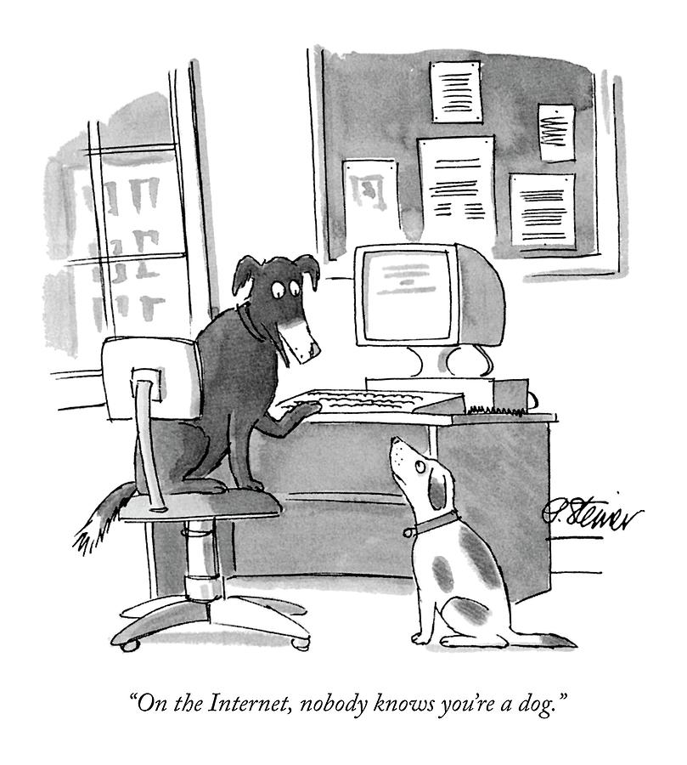
Project Context
Problem STATEMENT
* Peter Steiner, The New Yorker, July 5, 1993

Slide 3
What is digital identity?

Slide 4
Project Context
WHAT IS DIGITAL IDENTITY
A digital identity is information on an entity used by computer systems to represent an external agent.
That agent may be a person, organization, application, or device. ISO/IEC 24760-1 defines identity as "set of attributes related to an entity".
The term "digital identity" has also come to denote aspects of civil and personal identity that have resulted from the widespread use of identity information to represent people in computer systems.
Digital identity is now often used in ways that require data about persons stored in computer systems to be linked to their civil, or national, identities.
Furthermore, the use of digital identities are now so widespread that many discussions refer to "digital identity" as the entire collection of information generated by a person’s online activity.
Especially where that information is publicly available and not anonymized, and can be used by others to discover that person's civil identity.
In this wider sense, a digital identity is a version, or facet, of a person's social identity. This may also be referred to as an online identity.

Slide 5
Project Context
Self-Sovereign Identity PRINCIPLES
Existence
Control Access
Transparency
Persistence
Portability
Interoperability
Consent
Minimalization
Protection
Christopher Allen
http://www.lifewithalacrity.com/2016/04/the-path-to-self-soverereign-identity.html (April 2016)

Slide 6
Project Context
Use-case examples
Government Services
Simplify interactions with government agencies and services – such as filing taxes, applying for passports or securing support payments (e.g., Social Security)
Digital Services
Streamline and provide easier use of email, social media, movie/music streaming services, and rideshare platforms
Financial Services
Improve and speed the applicant identification process for establishing a new bank account, loan or payment service account
Commerce
Enable a more personalized and efficient shopping experience online and in stores, regardless of the payment type, device or service provider
https://newsroom.mastercard.com/press-releases/mastercard-microsoft-join-forces-to-advance-digital-identity-innovations/#__prclt=IarCgTyK

Slide 7
BASICS

Slide 8
BASICS
ROLE and actor MoDEL

Slide 9
BASICS
Simplified View

Slide 10
BASICS
SIMPLE EXAMPLE

Slide 11
PROJECT

Slide 12
PROJECT IDEA
USE CASE detail
Issuer
Schema definitions are stored on the ledger
Issuers store credential definitions on the ledger
These are derived from schemas
Basically, these are empty JSON files
No data is stored on the ledger in the whole process
E.g., every EU country could base their citizen data on the same schema
The credential definitions would be unique to each country’s government

Slide 13
PROJECT IDEA
USE CASE detail
Identity Holder and Issuer
Identity holder onboards with the issuer
E.g., thru a scanning a QR code at the issuer website
In this process a unique keypair is created
A unique distributed identifier (public DID) can be stored on the ledger
The public DID includes a DID document with endpoint and verification key information
Additionally a revocation registry is stored on the ledger
This can later be used if the issuer wants to revoke credentials

Slide 14
PROJECT IDEA
USE CASE Detail
Issuer offers digital credentials
The issuer offers digital credentials to the identity holder
This is exchanged via a secure connection
The identity holder can accept these credentials
The identity holder stores these credentials securely on the device

Slide 15
PROJECT IDEA
USE CASE Detail
Identity holder onboards with verifier
The identity holder connects via a QR code to the verifier (onboarding)
This is the same step as before between the issuer and the identity holder
Another unique keypair is generated

Slide 16
PROJECT IDEA
USE CASE Detail
Verifier requests credentials (proof request)
The verifier requests a proof on the subset of credentials needed to carry out the service, also including zero knowledge proofs
This is called a proof request
It is send via the secure connection

Slide 17
PROJECT IDEA
USE CASE Detail
Verifier receives proof
The identity holder generates the proof specifically for the requesting verifier based on the unique keypair connection
The identity holder sends the proof securely to the specific verifier as a reply
The identity holder can check if the the credentials within the proof are valid before answering to the proof request
Every entry in a credential can be seen as independent data, i.e., the identity holder can send a subset of the credentials
The identity holder can also add additional information which are not based on any issued credential, such as stating personal preferences, e.g., the favorite color, movie, or football club

Slide 18
PROJECT IDEA
USE CASE Detail
Verifier uses the information on the ledger to verify the proof
The verifier uses the information on the ledger to check the definitions (schema and credential) the proof is based on
The verifier uses the public DID to verify the connection between the issuer and the identity holder, including public key information
No other verifier can perform this action
The connection between each party is unique
Each proof is unique to the verifier
Each credential is unique to the identity holder

Slide 19
PROJECT IDEA
USE CASE overview

Slide 20
PROJECT IDEA
USE CASE overview with second verifier

Slide 21
Identity Holder = Prover

Slide 22
DEMO Video

Slide 23
SNET CONTRIBUTION
Software Components
Web UIs
REST API
Cloud Agent
Mobile Client
Schema Compiler and Validator
Indy SDK
Indy Ledger

Slide 24
REST API – Swagger and POSTMAN

Slide 25
SEQUENCE OF API CALLS
|-----------------------------------+---------------------------+-----------------------------+---------------------------|
| Steward | Issuer (Govt) | Prover (Jesse) | Verifier (Chamber) |
|-----------------------------------+---------------------------+-----------------------------+---------------------------|
| 1a. Create account with seed | 1b. Create account | 1c. Create account | 1d. Create account |
| 000000000000000000000000Steward1 | (if required) | (if required) | (if required) |
| (or send username/password to us) | | | |
|-----------------------------------+---------------------------+-----------------------------+---------------------------|
| 2. Assign TRUST_ANCHOR role | | | |
| to issuer (Optional) | | | |
|-----------------------------------+---------------------------+-----------------------------+---------------------------|
| | 3. Create a connection | | |
| | offer | | |
|-----------------------------------+---------------------------+-----------------------------+---------------------------|
| | 3. Create indy schema | | |
|-----------------------------------+---------------------------+-----------------------------+---------------------------|
| | 4. Create credentialdef | | |
|-----------------------------------+---------------------------+-----------------------------+---------------------------|
| | 5. Create credentialoffer | | |
| | for Jesse | | |
|-----------------------------------+---------------------------+-----------------------------+---------------------------|
| | | 6. Accept credentialoffer | |
|-----------------------------------+---------------------------+-----------------------------+---------------------------|
| | | 7. Send credentialrequest | |
|-----------------------------------+---------------------------+-----------------------------+---------------------------|
| | 8. Create a credential | | |
| | and send to Jesse | | |
|-----------------------------------+---------------------------+-----------------------------+---------------------------|
| | | | 9. Create proof request |
| | | | template (optional) |
| | | | 9a. send proof request |
|-----------------------------------+---------------------------+-----------------------------+---------------------------|
| | | 10. Retrieve proof requests | |
|-----------------------------------+---------------------------+-----------------------------+---------------------------|
| | | 11. Create and send proof | |
|-----------------------------------+---------------------------+-----------------------------+---------------------------|
| | | | 12. List received proofs |
| | | | along with their validity |
|-----------------------------------+---------------------------+-----------------------------+---------------------------|

Slide 26
IDENTITY PROJECT
Links
http://identitychain.snet.tu-berlin.de:8000/api/docs/#
https://github.com/ID-Chain
https://hub.docker.com/r/idchain/iea-api
https://hub.docker.com/r/idchain/test-pool
https://github.com/hyperledger/indy-node

Slide 27
TU Berlin
colleagues at the Hackathon
Sebastian Z
Zoltan
Ömer
Santhos
Martin
Sebastian G

Slide 28
Work in Progress and Final Results
WHAT is on the ledger and what not?
On the ledger (no data) | Off ledger (data)
Public DIDs and associated DID documents with verification keys and endpoints. | Private DIDs
Schemas and credential definitions | Private credentials
Revocation registries | Consent receipts or records of credential exchange transactions
Agent authorisation policies

Slide 29
Work in Progress and Final Results
Advantages for Issuers and verifiers
Issuer (without interaction of verifier) | Verifier (without interaction of issuer)
Create and issue any type of credential without waiting for a central body or data hub to update its limited transaction set to accommodate it | Confirm that the data provided to them (or proofs about such data) by an identity holder came from the stated issuer
Revoke credentials that it issues, without needing to create complex and privacy-leaking user experiences or handle multiple technical integrations with thousands or millions of relying parties | Verify that the data is unchanged
Provide its customers with trustworthy digital credentials that can be used anywhere in the world instantly | Verifiy that the data was provided only to the identity holder who has presented it
Revoke the ability of a lost/stolen device to be used to fraudulently represent the identity holder | Verifier that the data has not been revoked by the issuer

Slide 30
Work in Progress and Final Results
ADVANTAGES
Decentralized solution, no central authority
Ledger type: public permissioned
A trust anchor (e.g., government) is added through an onboarding process
Every secure actor-to-actor relation is unique, pseudonymously registered on the ledger
Public data schemas are stored on the ledger, signed by an actor, e.g., trust anchor
The ledger can be used to verify identity information of an actor
The ledger can be used to check the origin relation of the identity information, i.e., who provided the information
No private information, not even in hashed form, is stored on the ledger
Actors have control over which data they provide to another actor

Slide 31
Dipl.-Inform. Sebastian Zickau, Bersant Deva, M.Sc., Dr. Sandro Rodriguez Garzon
TU Berlin | Telekom Innovation Laboratories | Fachgebiet Service-centric Networking
Ernst-Reuter-Platz 7 | 10587 Berlin | Germany
sebastian.zickau@tu-berlin.de, bersant.deva@tu-berlin.de, sandro.rodriguezgarzon@tu-berlin.de
https://www.snet.tu-berlin.de/

